Slide 1
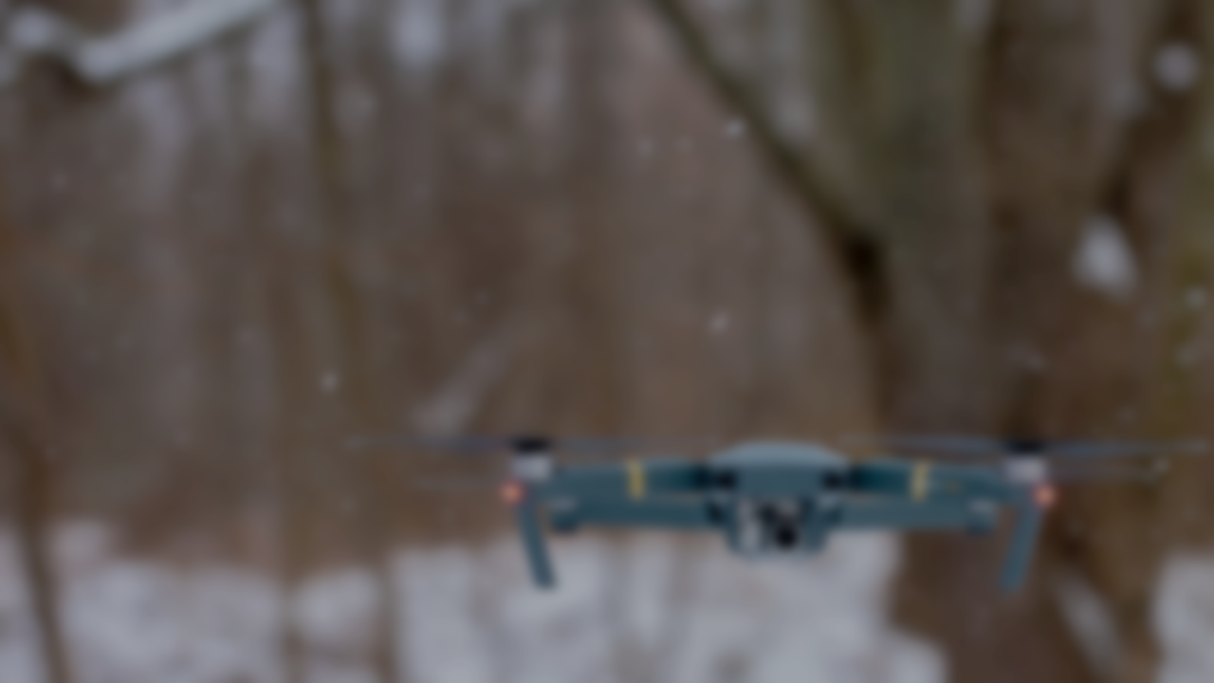
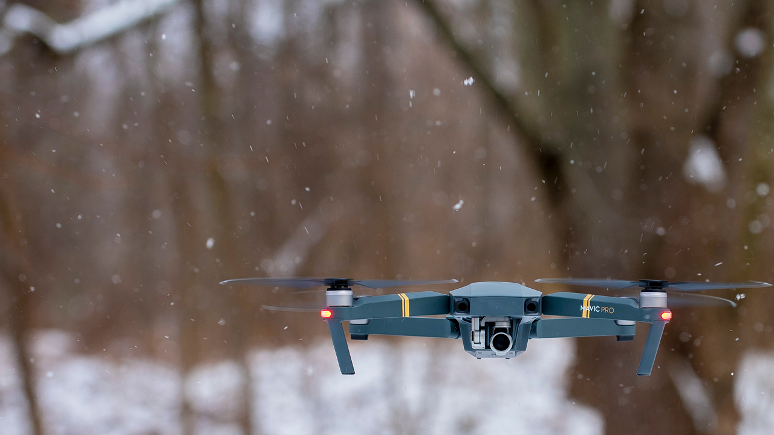
Drone Localization in Ad-hoc Indoor Environment
Marcell Rausch
2019.12.11

Slide 2
Task
The student’s task is to develop a positioning system by placing stationary LIDAR sensors on a drone, to collect range measurements of its environment and use a SLAM algorithm to find the current position. The position and orientation of these sensors is fixed relative to the drone’s frame and scanning of the drone’s environment is done by orientation changes that happen due to the natural motion during flights.

Slide 3
Current status of work
What I have worked on during this semester
Literature review
Learned about ROS, Gazebo, PX4 and how to use them for drone simulations
Reviewed ranging sensors
Reviewed SLAM techniques
Reviewed available SLAM packages in ROS
20%
40%
40%

Slide 4
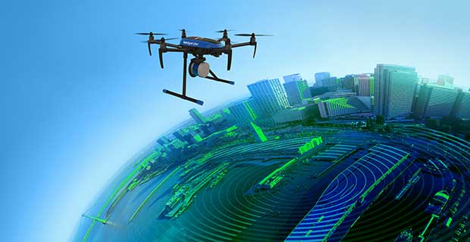
Motivation
Typically used sensors for mapping and localization
3D LIDAR scanners
Accurate
Heavy for small vehicles
Sensitive
Expensive
Monocular, stereo or RGB-D camera
Detailed maps
High amounts of data
Requires high computation

Slide 5
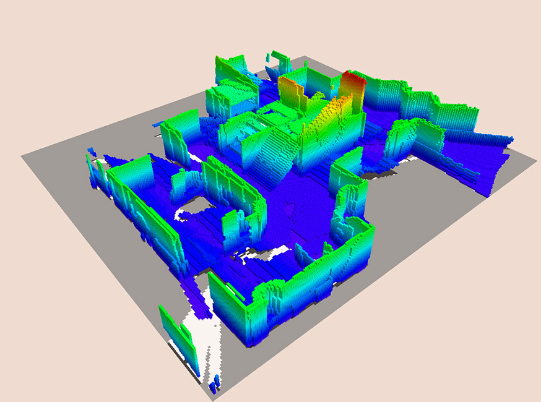
Goal
Localization and mapping in indoor environment
Using stationary LIDAR sensors
Scanning the whole 3D range
Online computation
Why stationary sensors?
Lightweight
No effect on flight behavior
Low computation requirements
In solutions where localization and mapping is needed, but processing is a limited resource

Slide 6
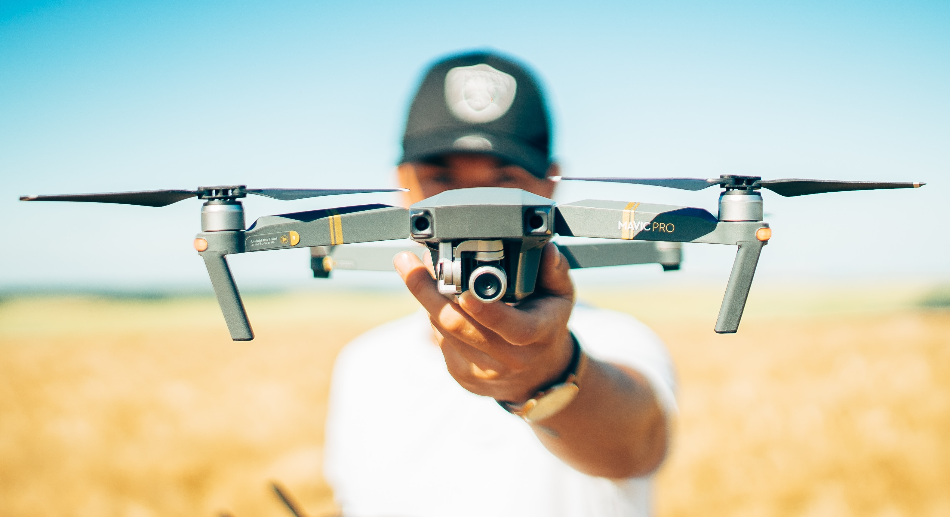
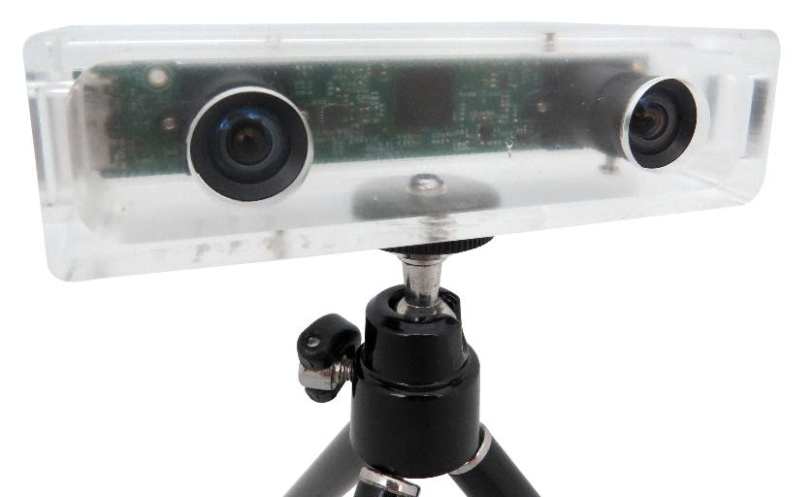
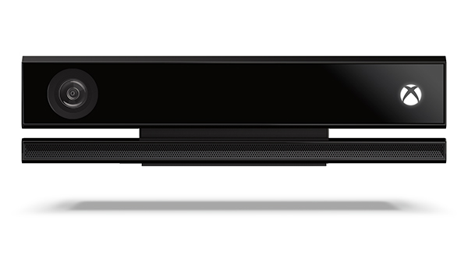
Data acquisition – Visual
Monocular camera
Cheap
Subject to changes in lighting conditions
Scale-drift
Stereo camera
Requires calibration
Subject to changes in lighting conditions
Patterns on images cause ambiguity
RGB-D camera
Requires calibration
Lightning conditions do not affect measurements indoor

Slide 7
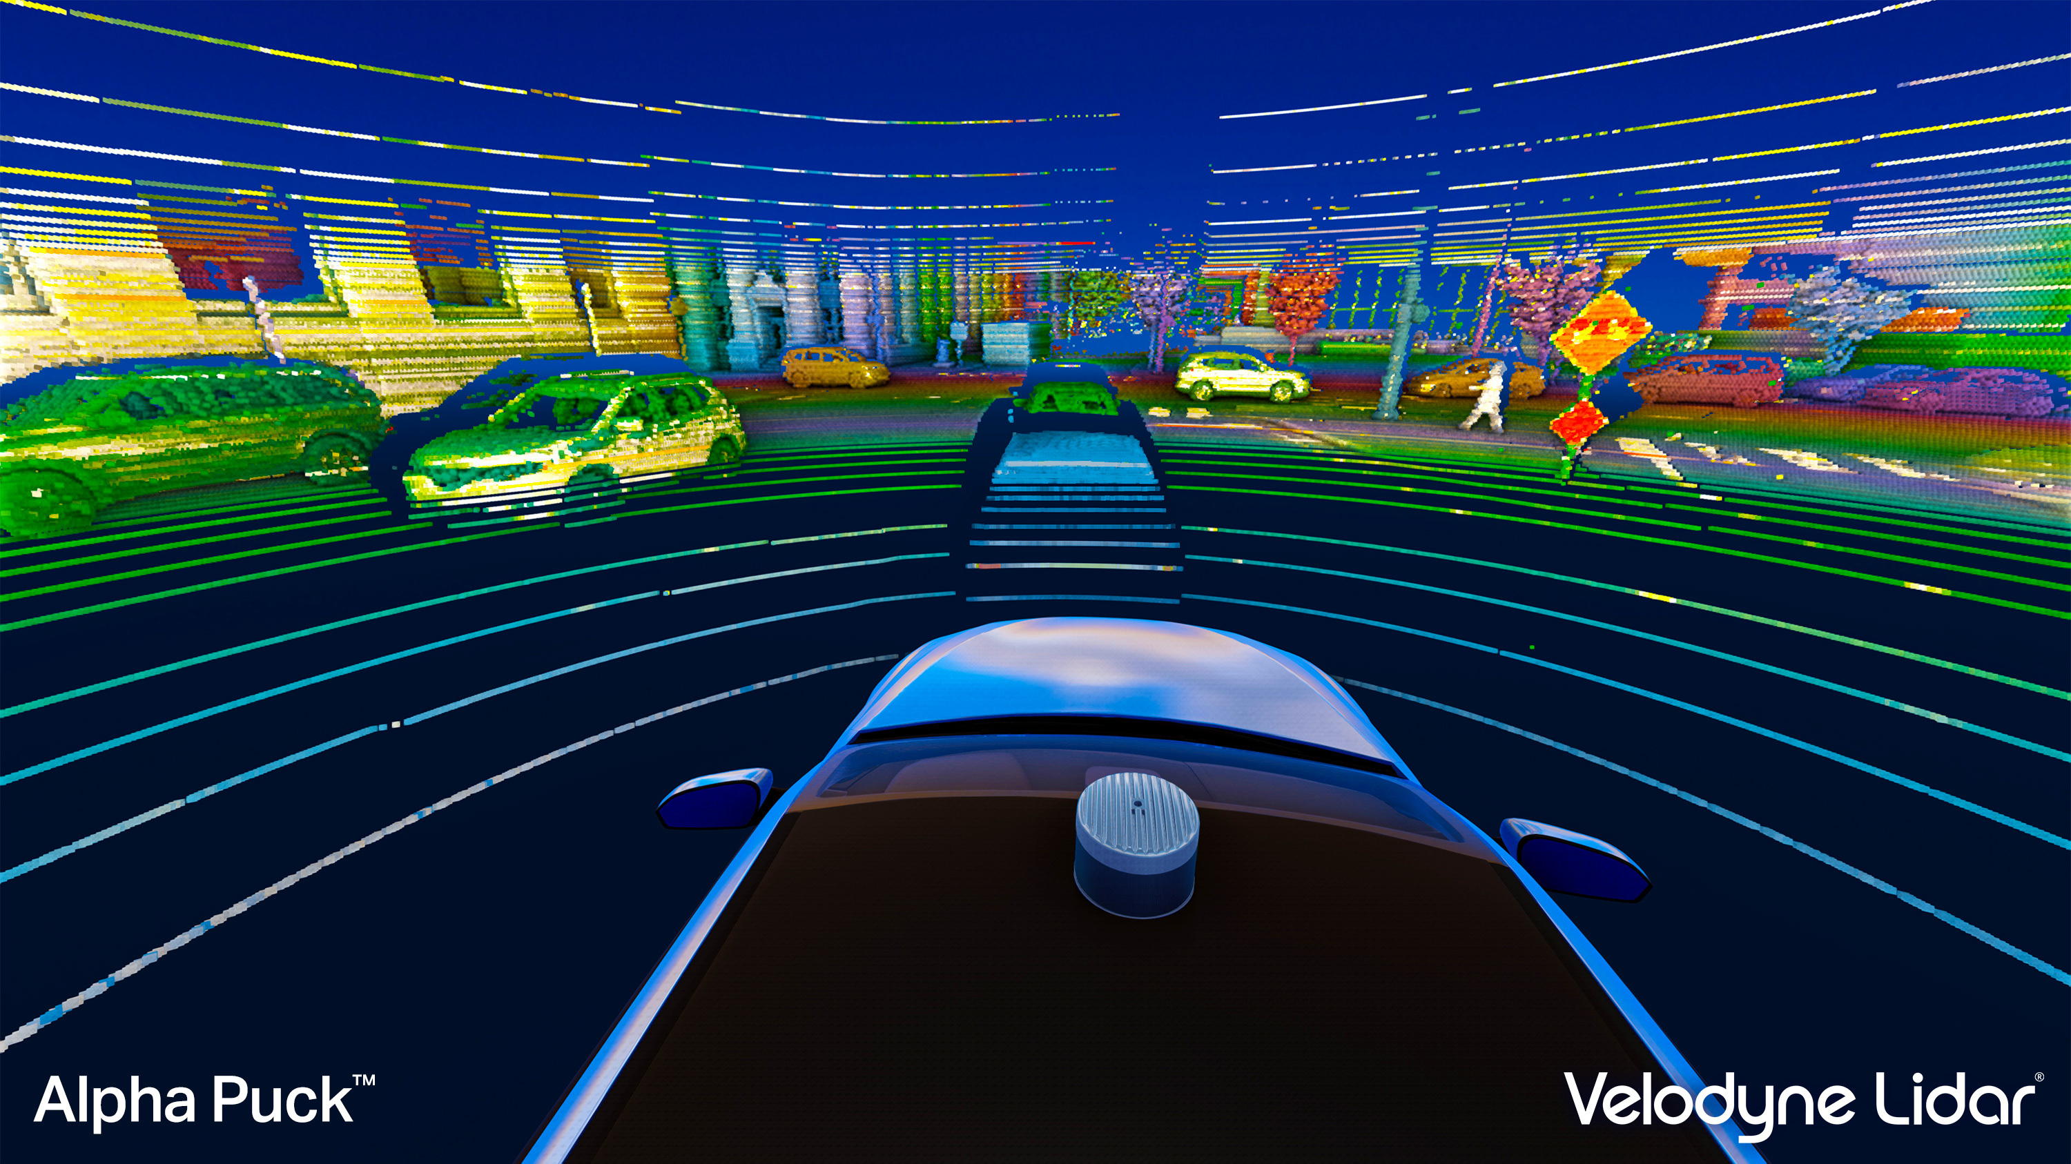
Data acquisition – Ranging sensor
Ultrasonic sensor
Range up to 5 m
Mirrors and windows block signal
Unpopular in robotics for mapping purposes
LIDAR
Up to 500Hz sampling rate
Down to mm level precision
100m range
Mirrors and windows are transparent to LIDAR

Slide 8
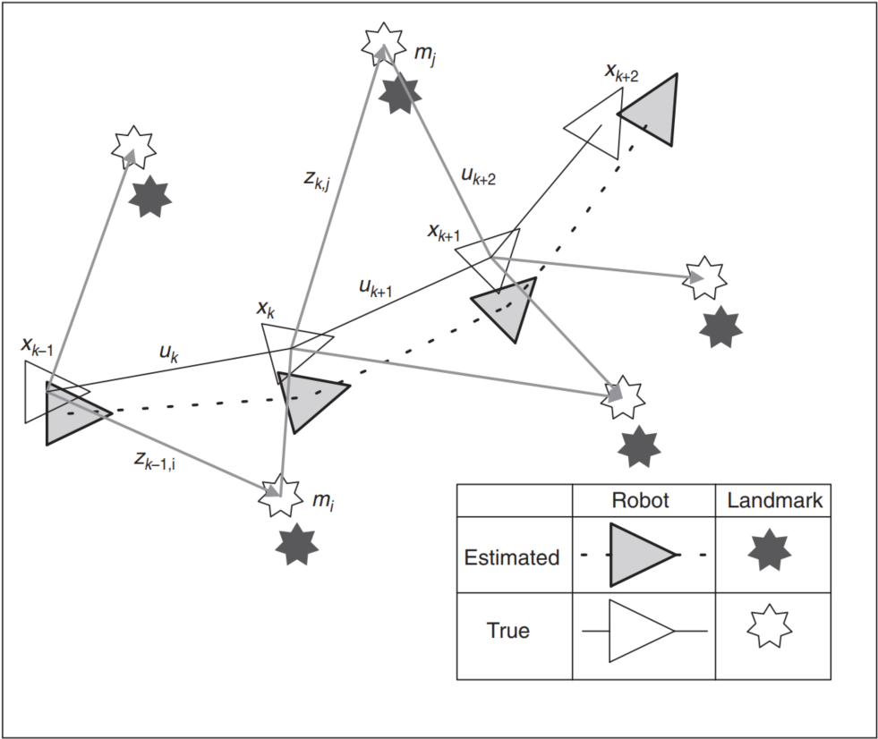
Simultaneous Localization And Mapping
Proposes the issue of simultaneously localizing a robot and mapping its environment
The robot makes relative observations of a number of landmarks using sensors
Estimates its trajectory and location of landmarks

Slide 9
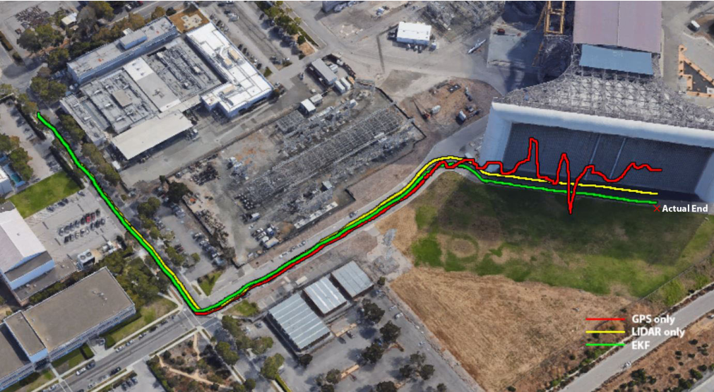
SLAM solutions – Improve position accuracy
LIDAR SLAM as additional input
Fusion of GPS, IMU and LIDAR SLAM
Adaptive Extended Kalman Filter
GPS drift of 24.3m reduced to 3.42m
HENING, Sebastian, et al. 3D LiDAR SLAM integration with GPS/INS for UAVs in urban GPS-degraded environments. In: AIAA Information Systems-AIAA Infotech@ Aerospace. 2017. p. 0448.

Slide 10
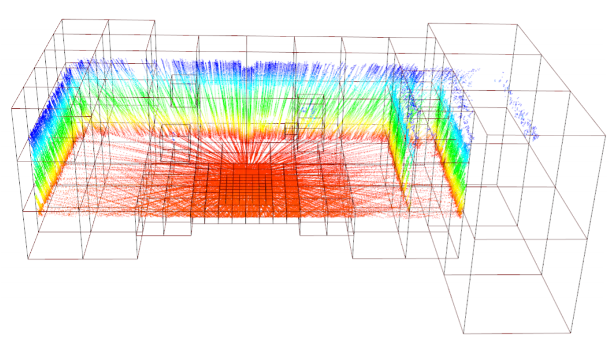
SLAM solutions – Improve online mapping accuracy
Inputs: LIDAR scan and IMU
Range measurements aggregated into grid-maps
Local map registration in Global map based on Surfels
Map and trajectory refinement on background thread
DROESCHEL, David; BEHNKE, Sven. Efficient continuous-time SLAM for 3D lidar-based online mapping. In: 2018 IEEE International Conference on Robotics and Automation (ICRA). IEEE, 2018. p. 1-9.

Slide 11
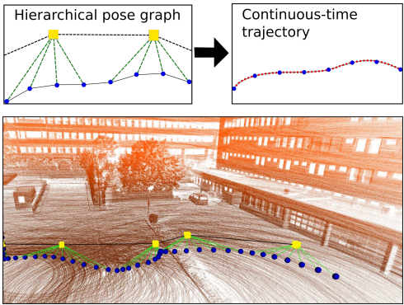
SLAM solutions – Improve online mapping accuracy
Inputs: LIDAR scan and IMU
Range measurements aggregated into grid-maps
Local map registration in Global map based on Surfels
Map and trajectory refinement on background thread
DROESCHEL, David; BEHNKE, Sven. Efficient continuous-time SLAM for 3D lidar-based online mapping. In: 2018 IEEE International Conference on Robotics and Automation (ICRA). IEEE, 2018. p. 1-9.

Slide 12
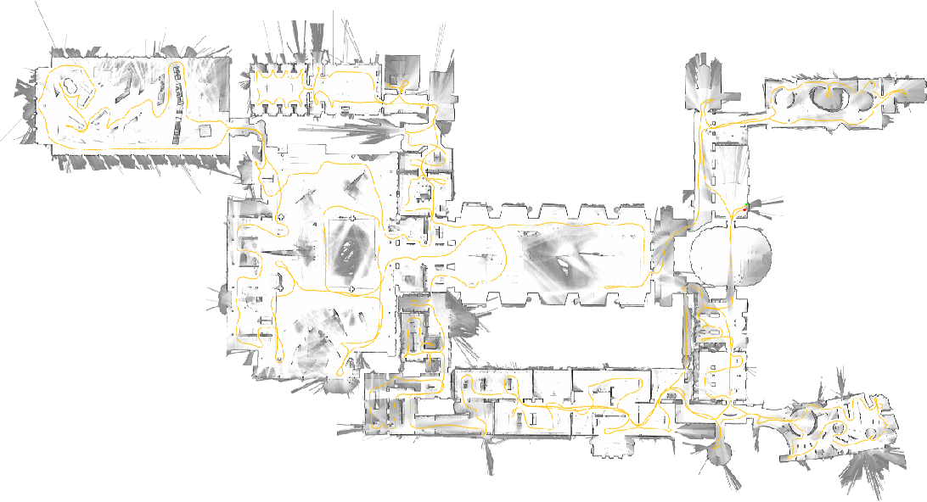
Google Cartographer SLAM
Inputs: LIDAR scan and IMU
2D and 3D online SLAM
Used by Google street view
Great community
Available as ROS package
Ready to use

Slide 13
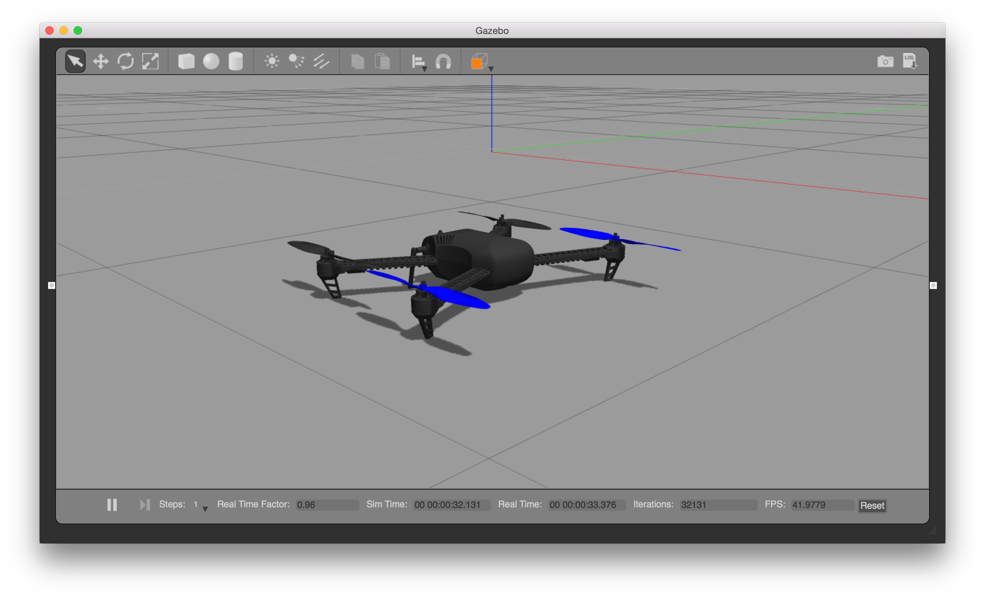
Simulation – Main parts
Robot Operating System
Publish-Subscribe Communication
Rich in libraries for robotics
Used for robot control
Gazebo
Simulation environment
Mainly used for robot simulations
Robots inside Gazebo can be controlled using ROS
PX4 autopilot software
Processes sensor information
Generates control signals for motors

Slide 14
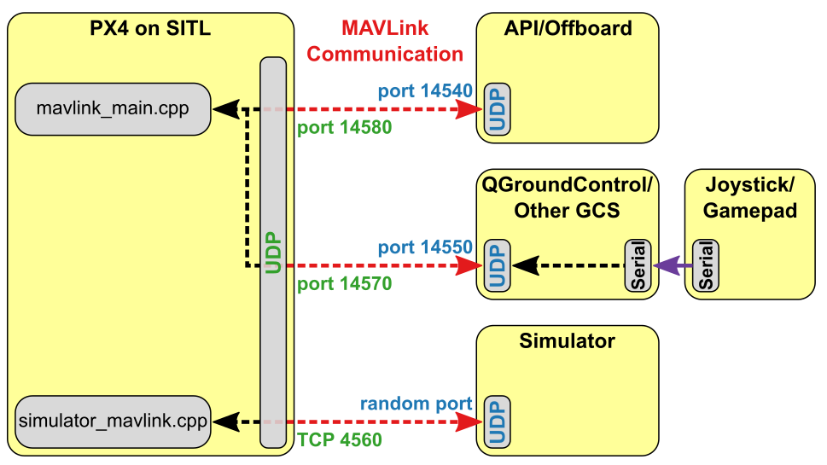
Simulation using PX4 repository
PX4 repository contains simulation files for Gazebo
PX4 on SITL flight controller
MAVROS forwards MAVLink messages to ROS
Gazebo simulates an Iris quadcopter

Slide 15
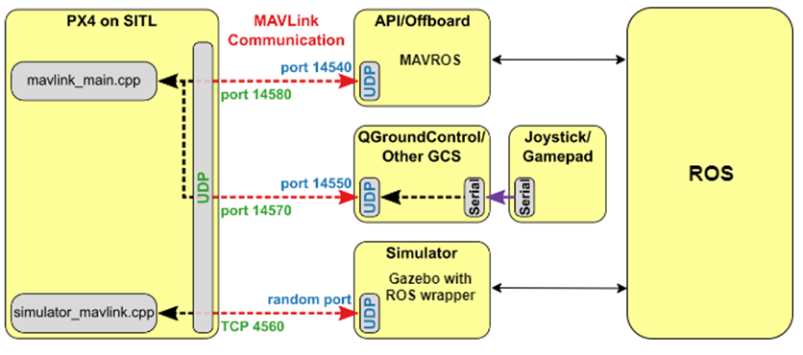
Simulation using PX4 repository – LIDAR measurements to ROS topics
LIDAR measurements are not forwarded by MAVROS
Gazebo started with ROS wrapper
LIDAR measurements are forwarded straight to ROS topics

Slide 16
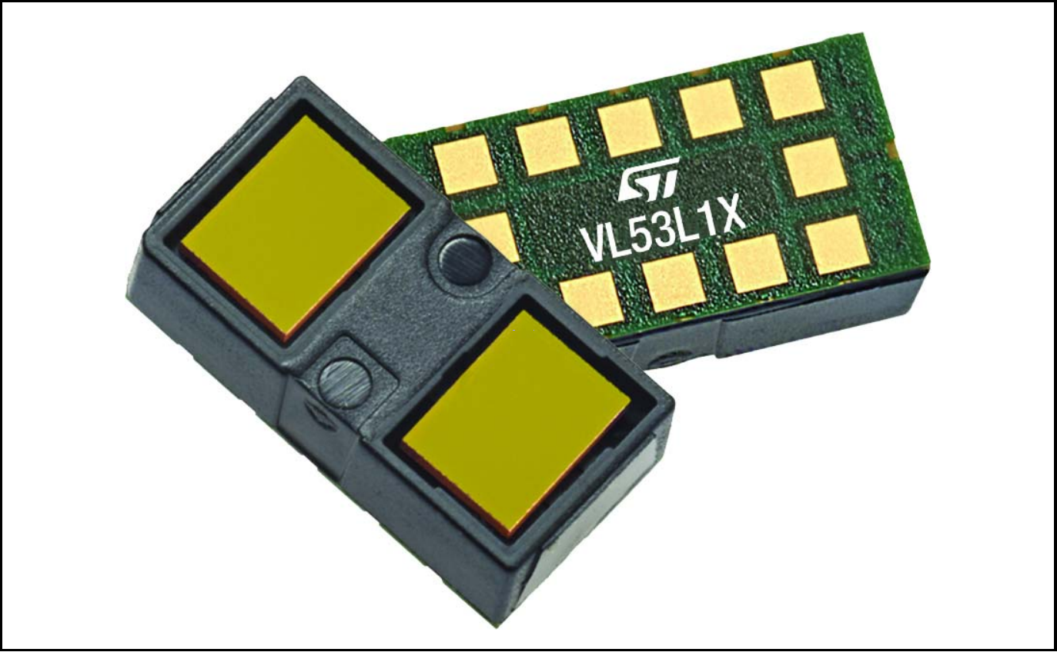
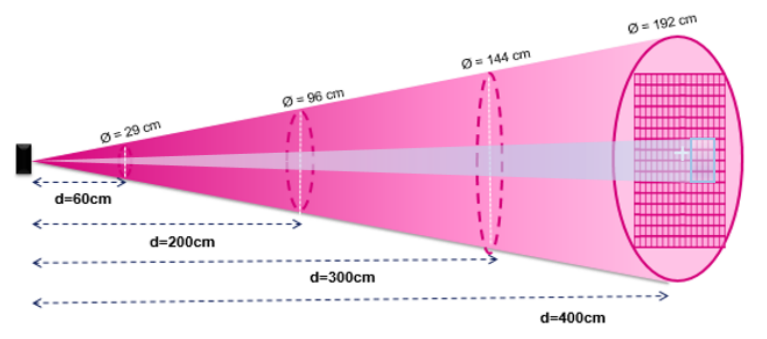
VL53L1X LIDAR
4m maximum range
50Hz maximum sampling rage
Small size: 4.9x2.5x1.56mm
27° Field of view
Adjustable Region of Interest

Slide 17
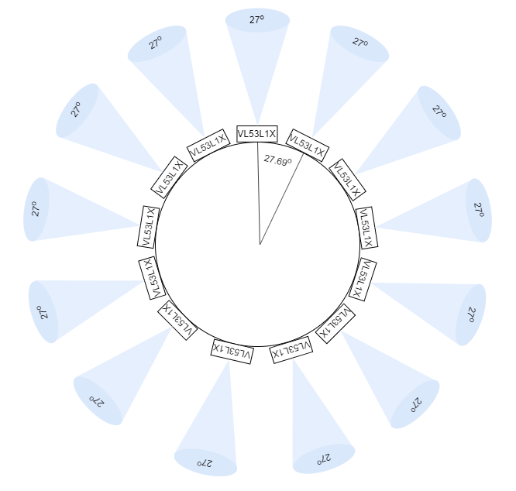
Initial LIDAR layout for 2D SLAM
13 sensors
Covers 351° of the plane
Doesn’t take into account the changes in yaw angles
Only used in simulations to gain experience
3D layout is design based on experience gained during simulations using this layout

Slide 18
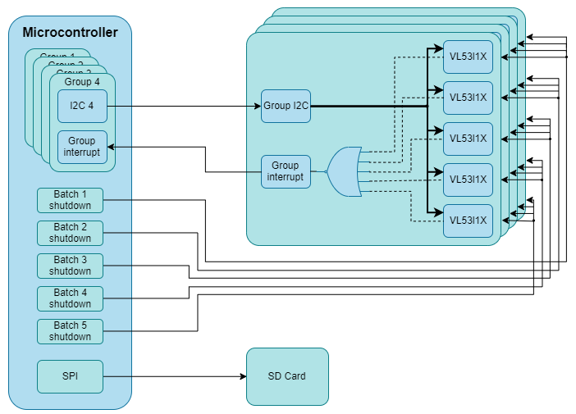
Hardware design for real world data collection and offline processing
Design for 20 sensors with 50 Hz update rate
Microcontroller reads data from each sensor
Saves measurements on an SD Card
SLAM algorithm runs offline

Slide 19
Thank you for your attention!

